Slide 1
COMICSWORLD WEBSITE
GAORANGERS
Home
About us
Content
Reference
Let’s take a quick view of our product

Slide 2
MEMBER
GAORANGERS
Home
About us
Content
Reference
Phạm Phú Toàn 21127183
Nguyễn Trần An Hòa 21127047
Tô Khánh Linh 21127638
Nguyễn Thuận Phát 21127665
Ngô Quốc Qúy 21127679

Slide 3
INTRODUCTION
COMICSWORLD is a website which allows authors who are interested in writing their own comics but their work is not recognized by the public. This website gives them a chance to share their new work and attracts more comics readers to enjoy them.
This website has some functions to support uploader and member reader like:
Creating a comic
Uploading new chapter
Reading comic
Commenting
Rating
Following…

Slide 4
“In all sections of this presentation, we will go through screens of Comics World website”
GAORANGERS
Home
About us
Content
Reference

Slide 5
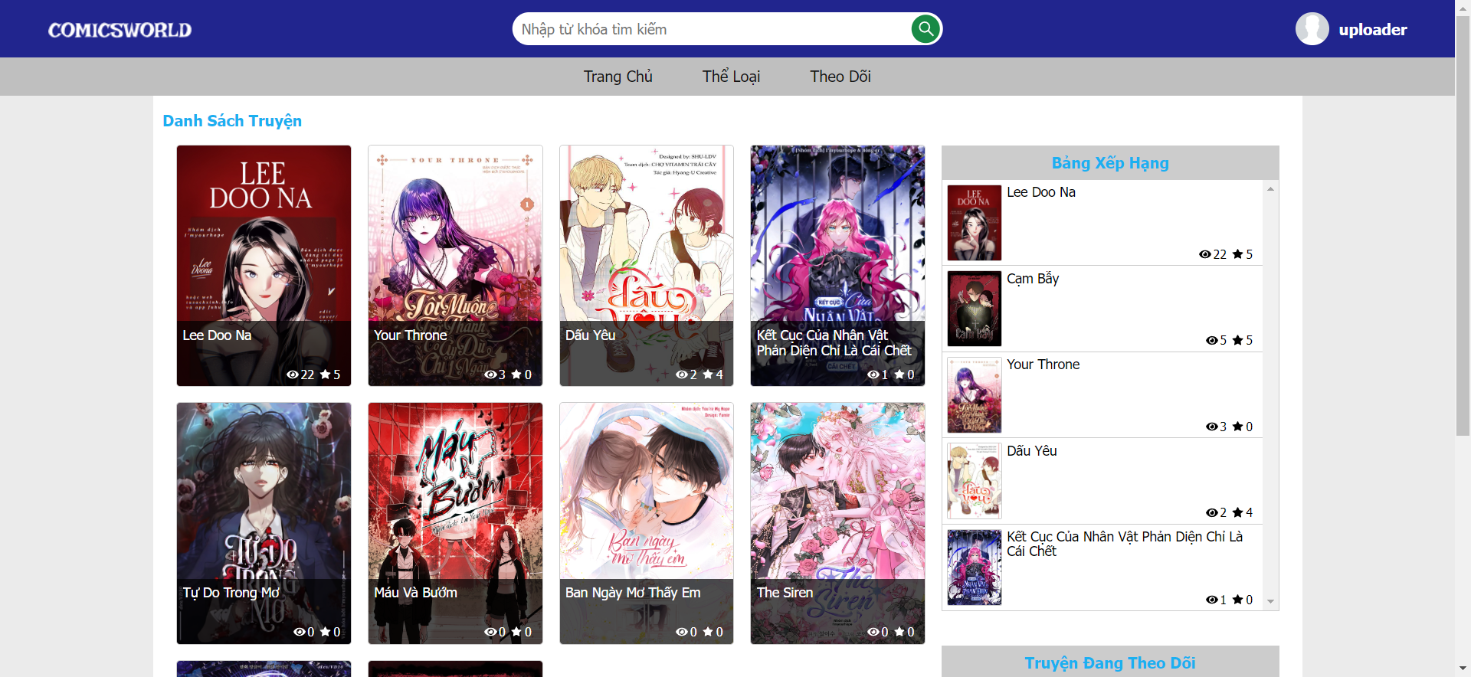
HOMEPAGE

Slide 6
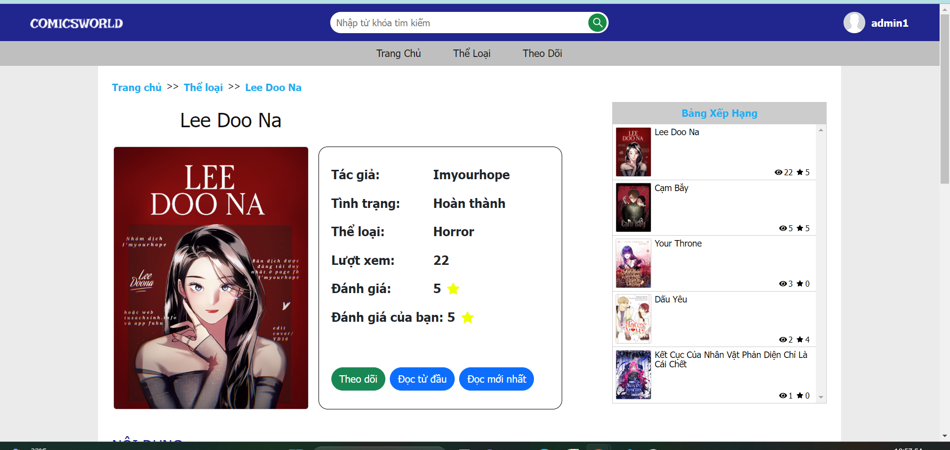
PAGE COMIC

Slide 7
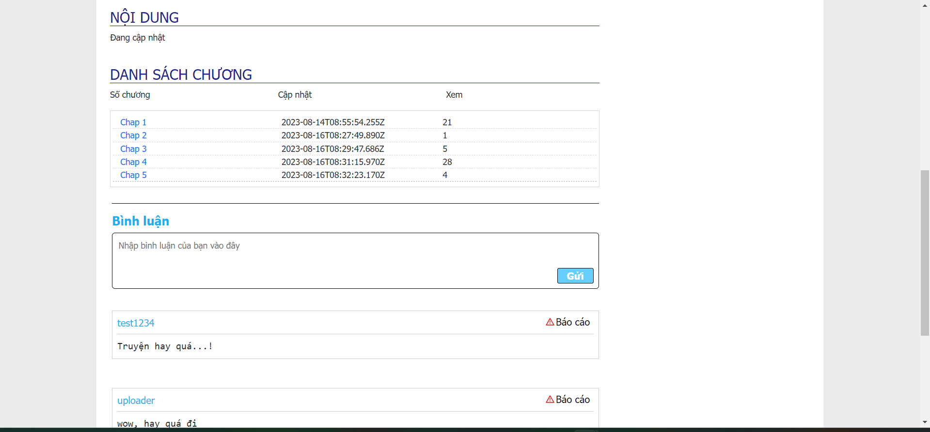
PAGE COMIC

Slide 8
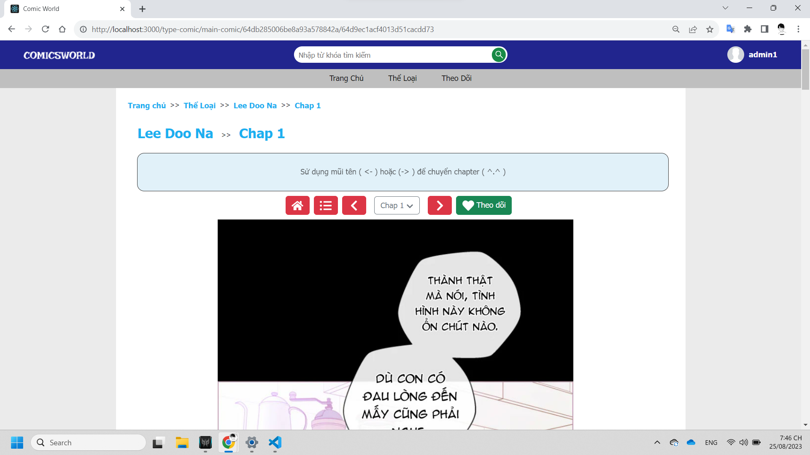
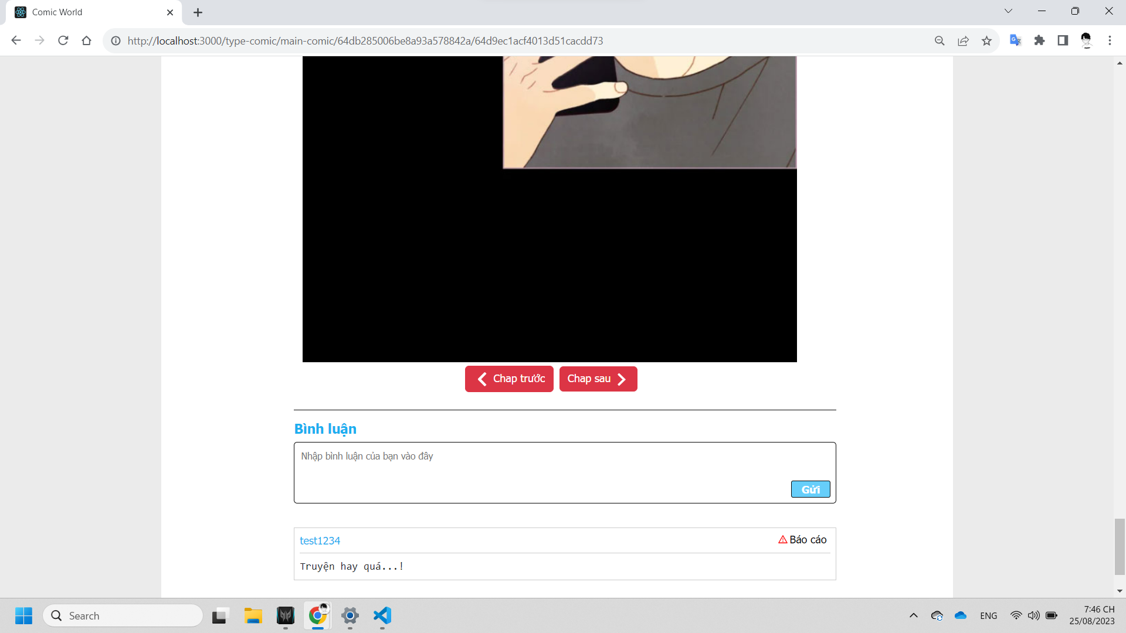
PAGE READING COMIC

Slide 9
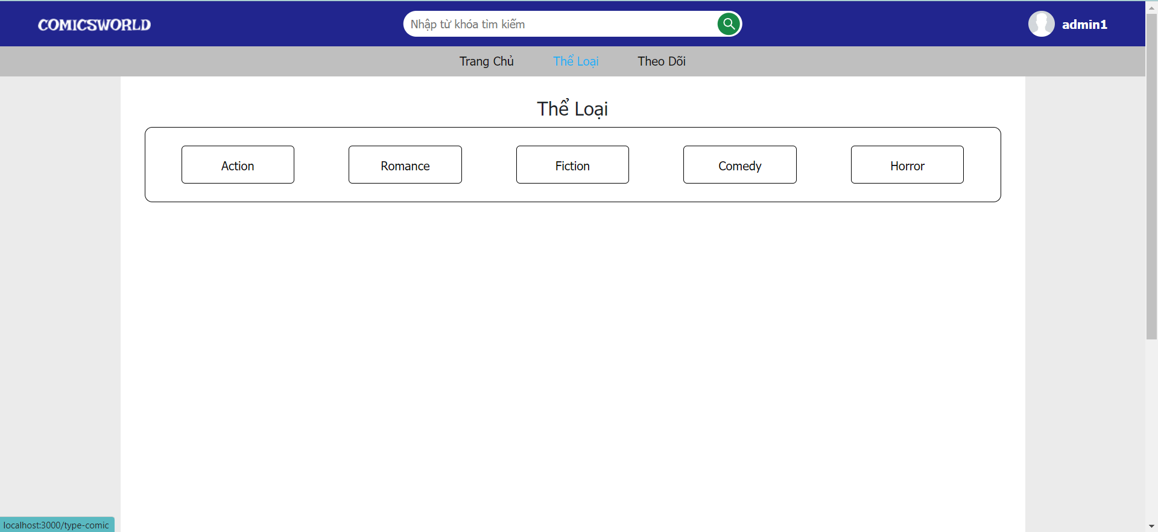
PAGE TYPE OF COMIC

Slide 10
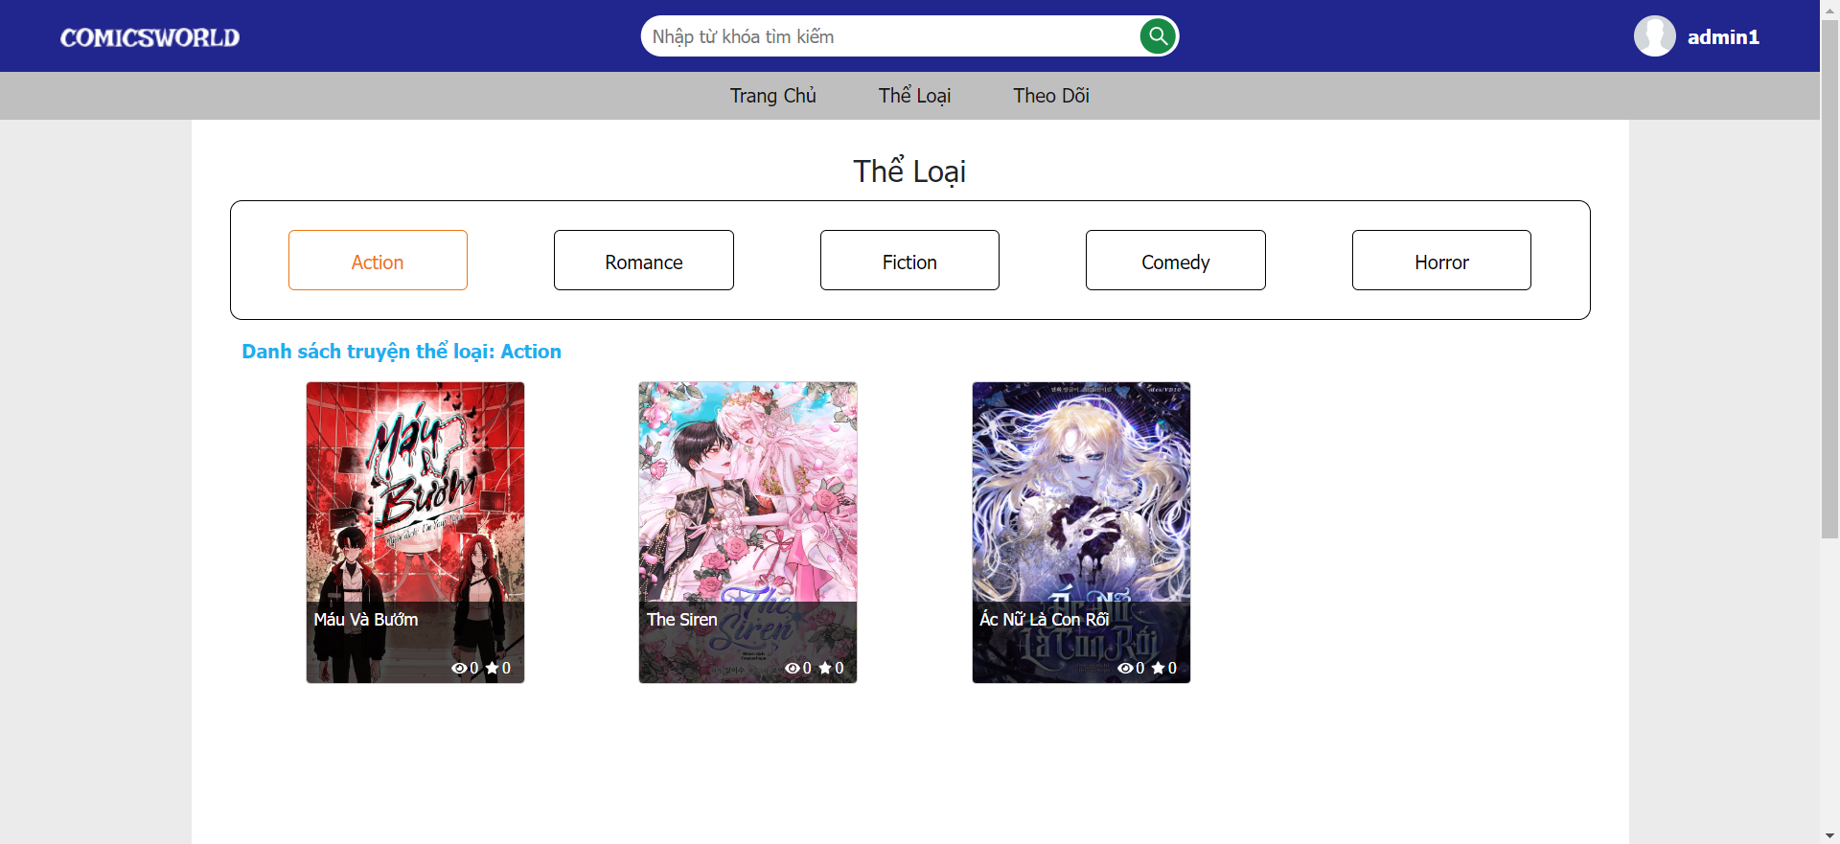
PAGE TYPE OF COMIC

Slide 11
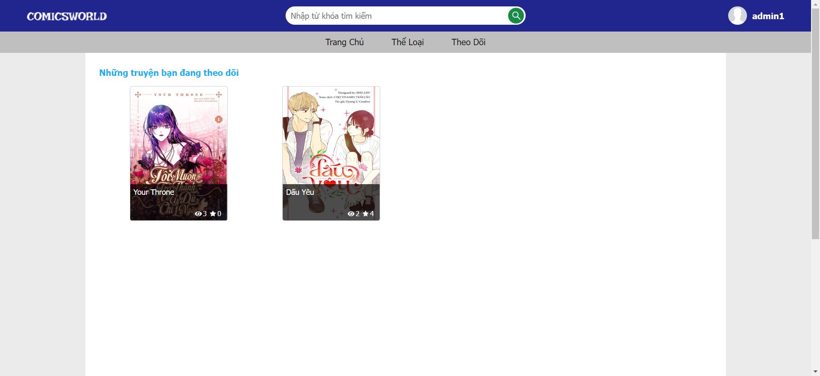
PAGE FOLLOWING COMICS

Slide 12
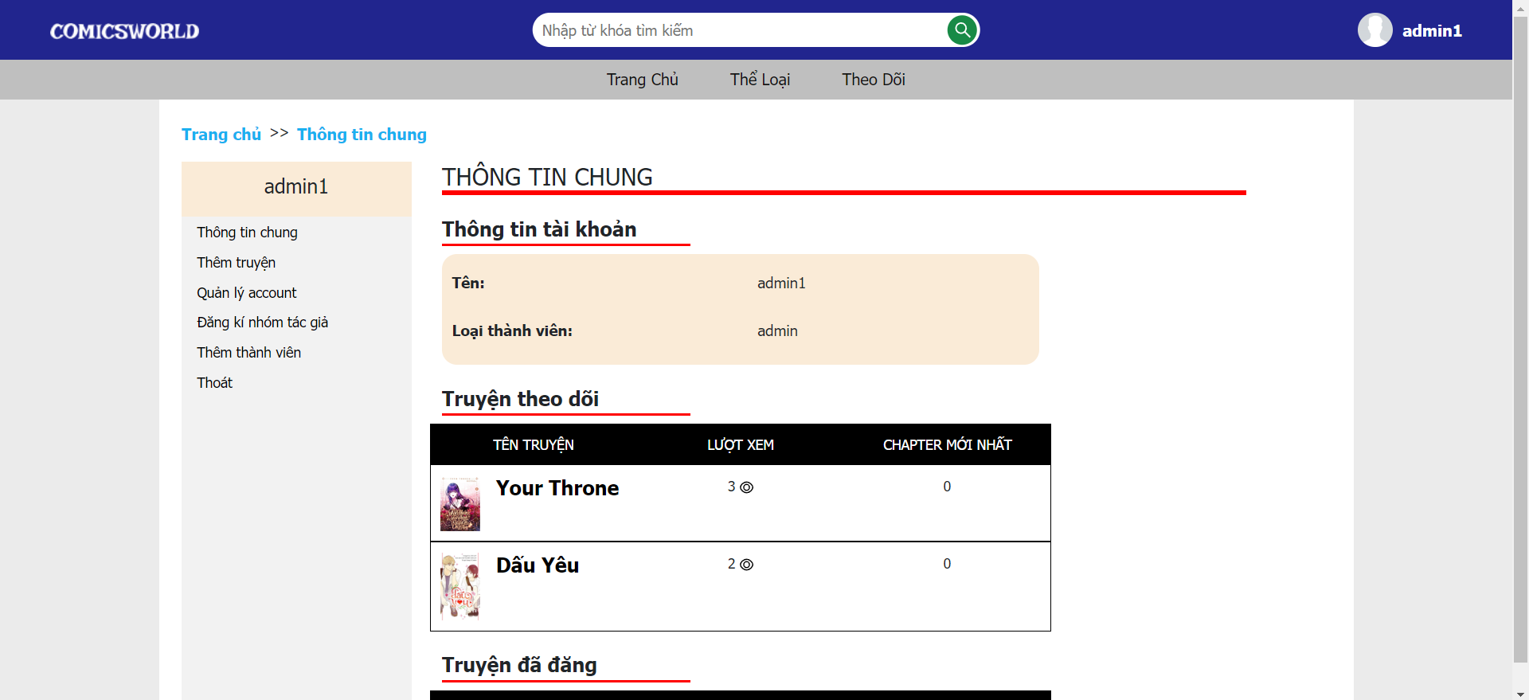
PAGE PROFILE (ADMIN): Thông tin chung

Slide 13
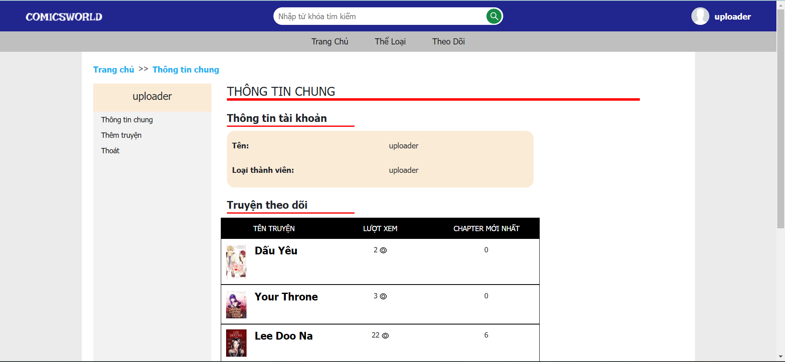
PAGE PROFILE (UPLOADER): thông tin chung

Slide 14
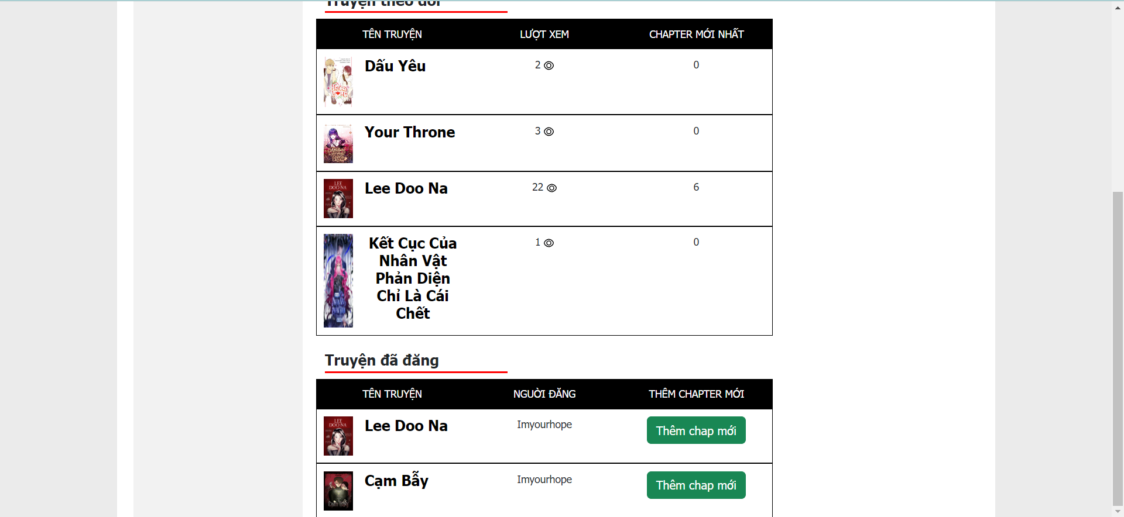
PAGE PROFILE (UPLOADER): thông tin chung

Slide 15
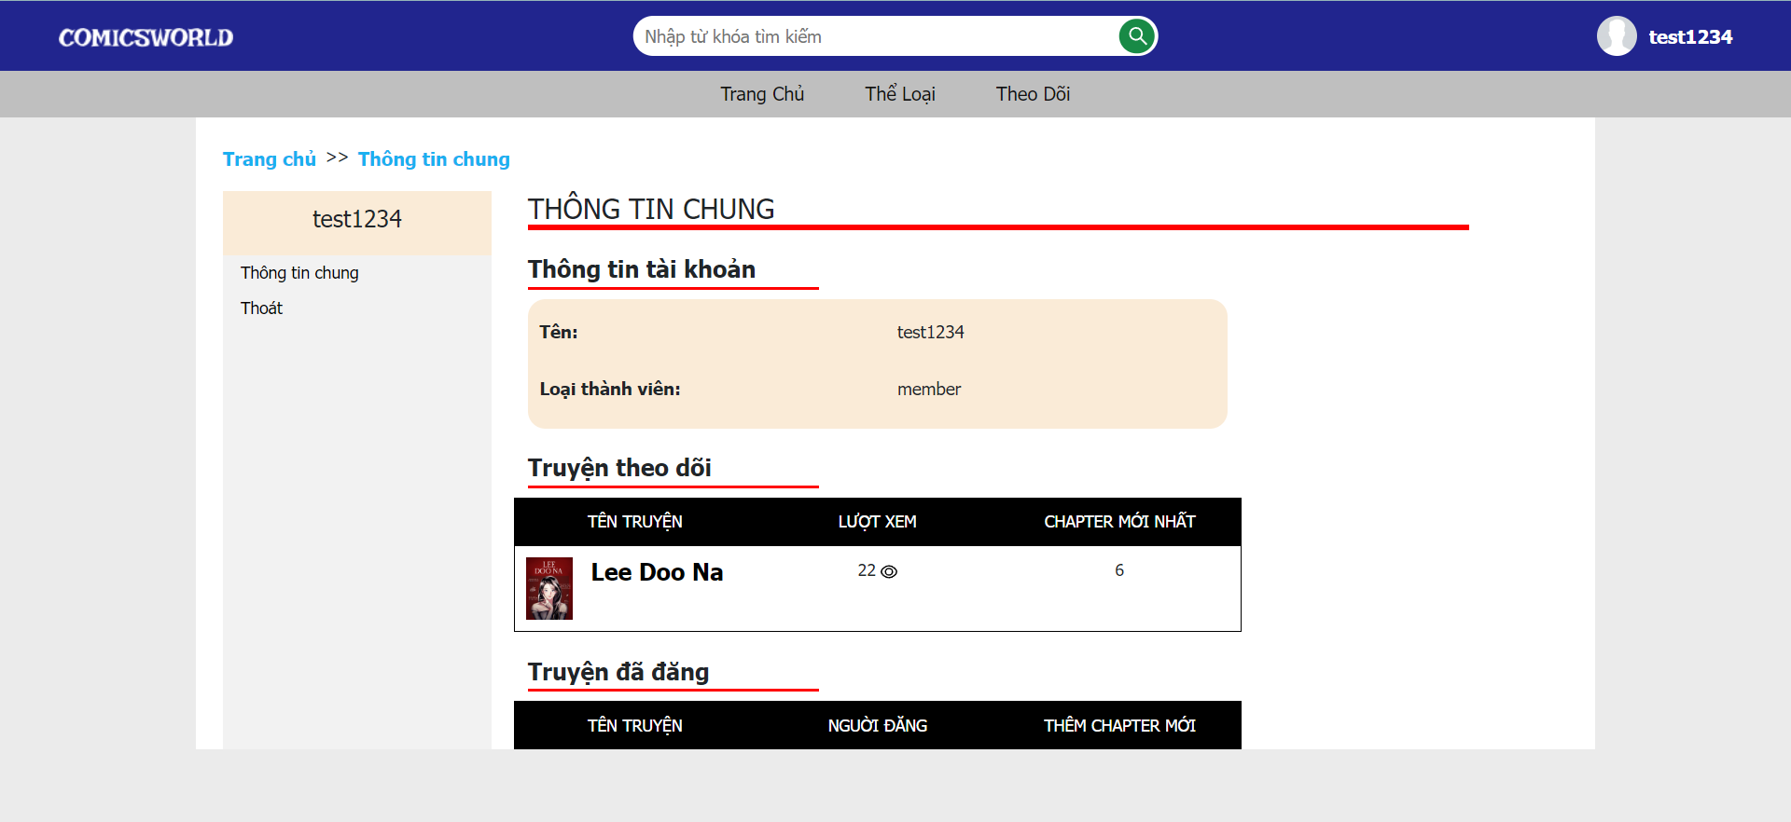
PAGE PROFILE (MEMBER)

Slide 16
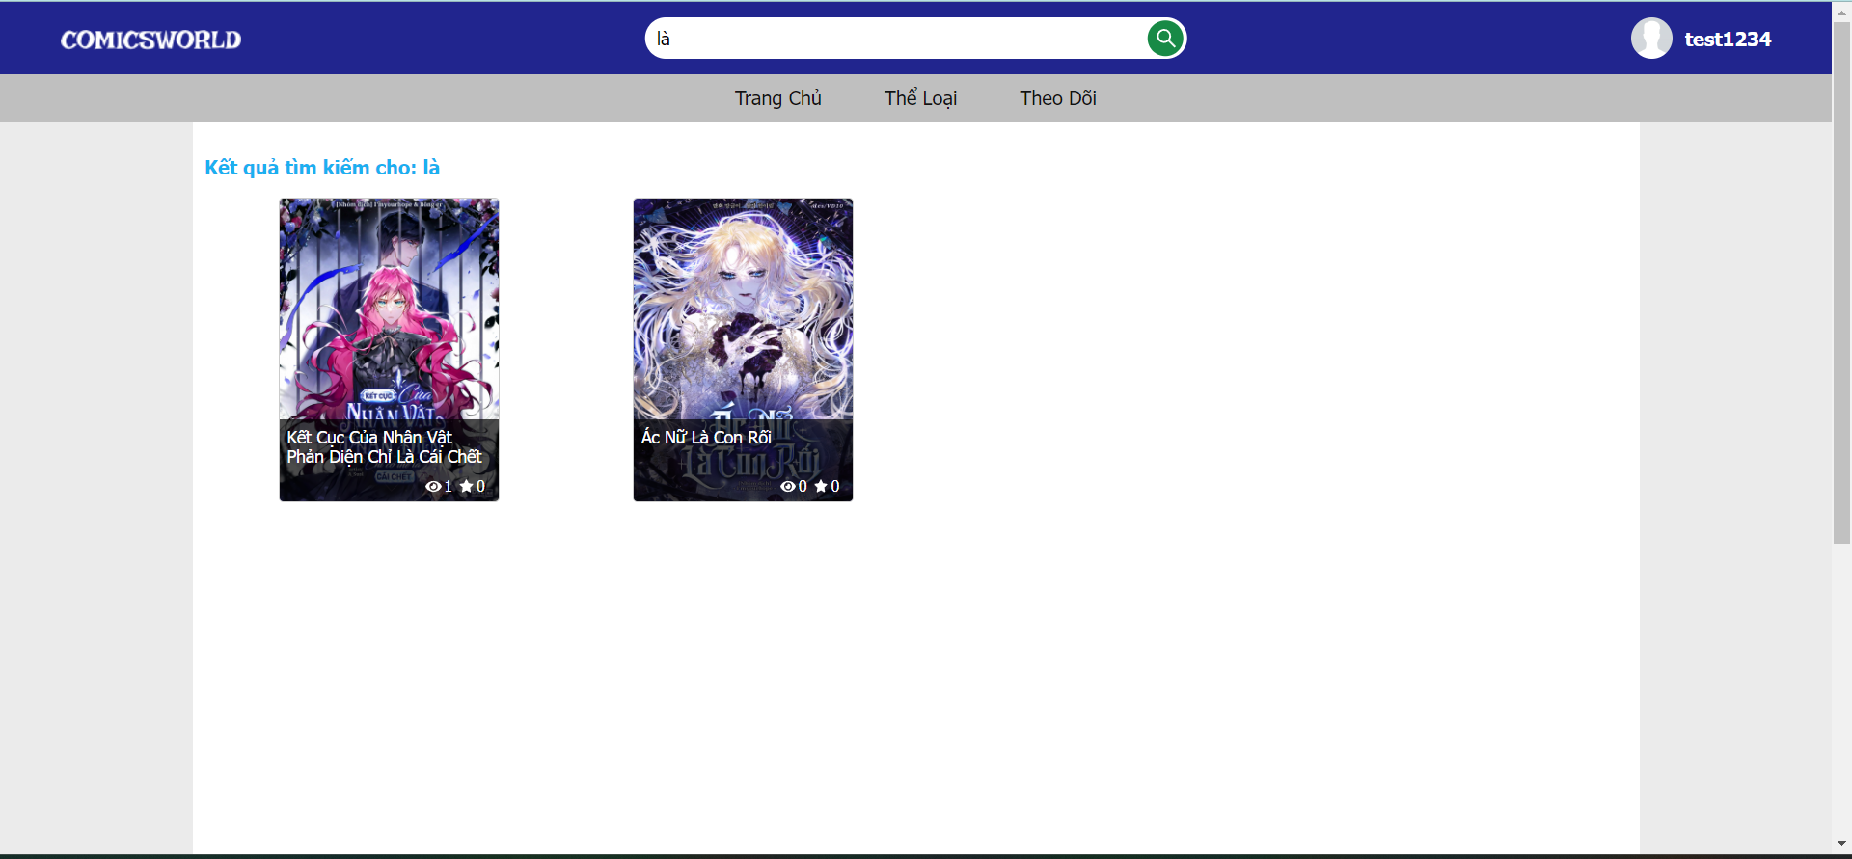
SEARCHING PAGE

Slide 17
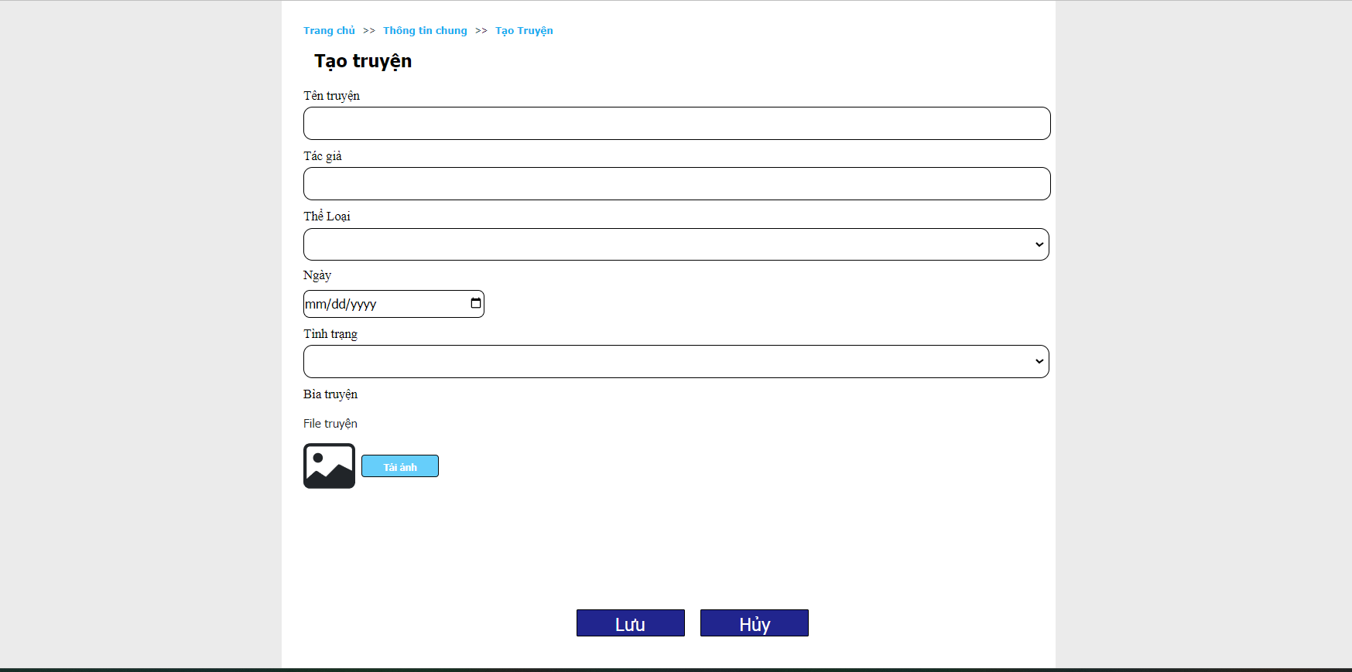
CREATING COMICS PAGE

Slide 18
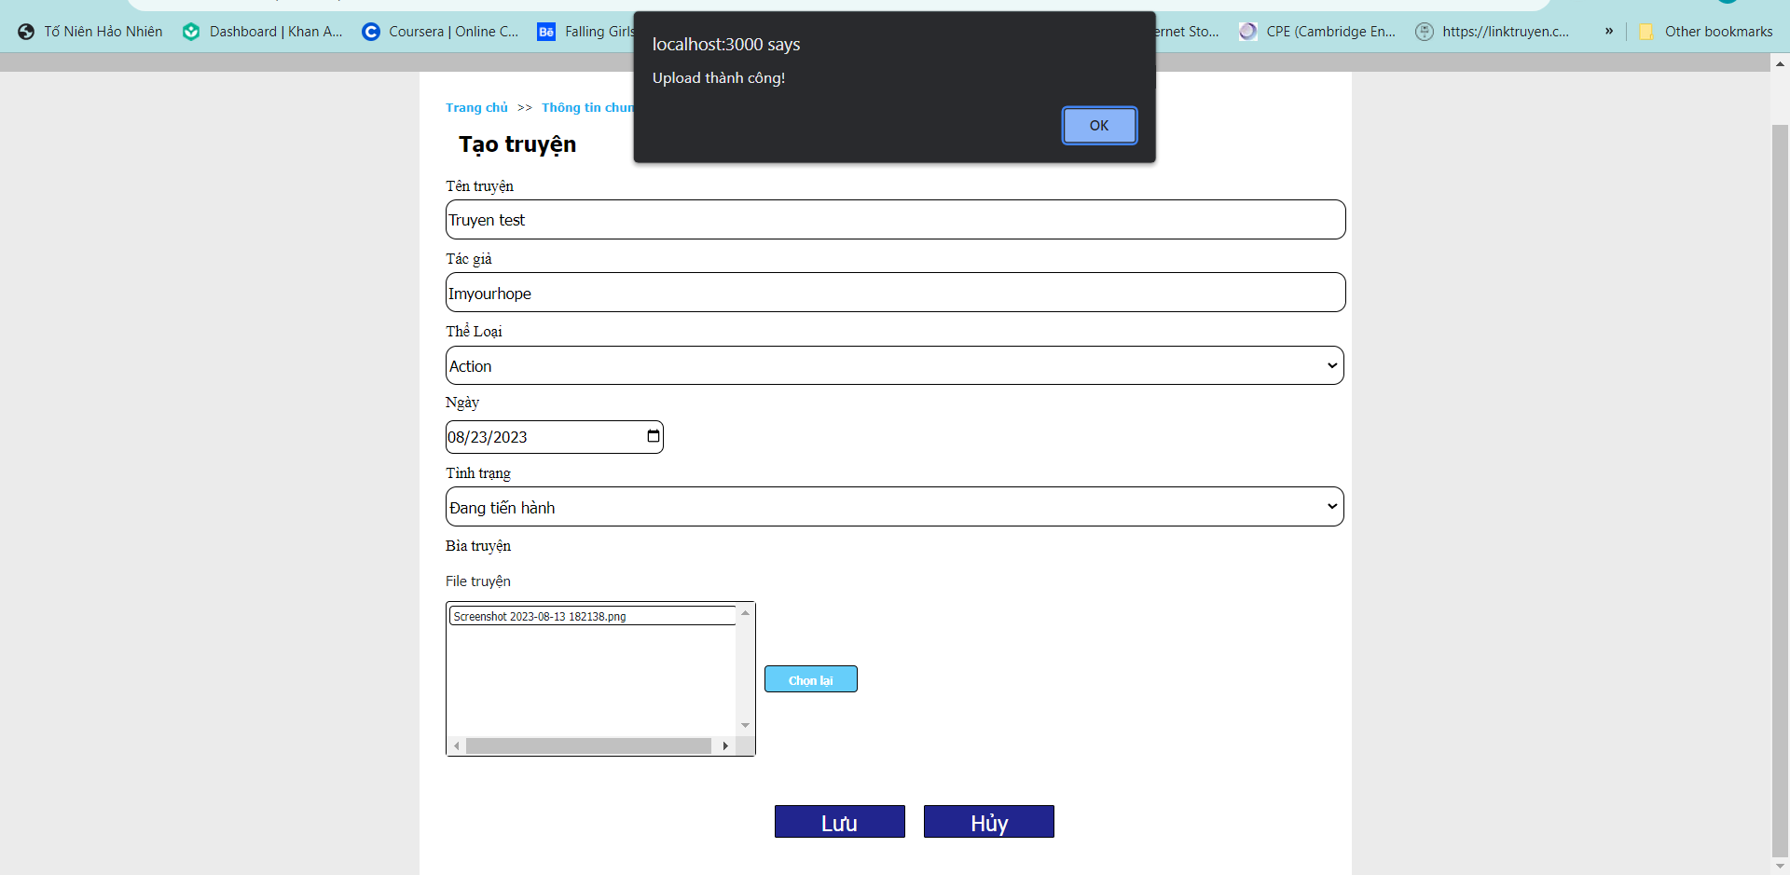
CREATING COMICS PAGE (SUCCESSFULLY)

Slide 19
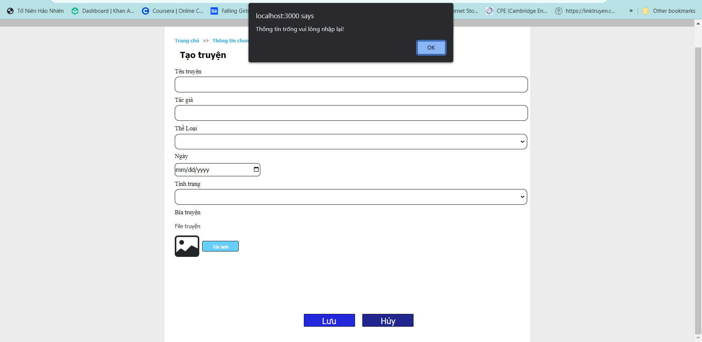
CREATING COMICS PAGE
(FAIL)

Slide 20
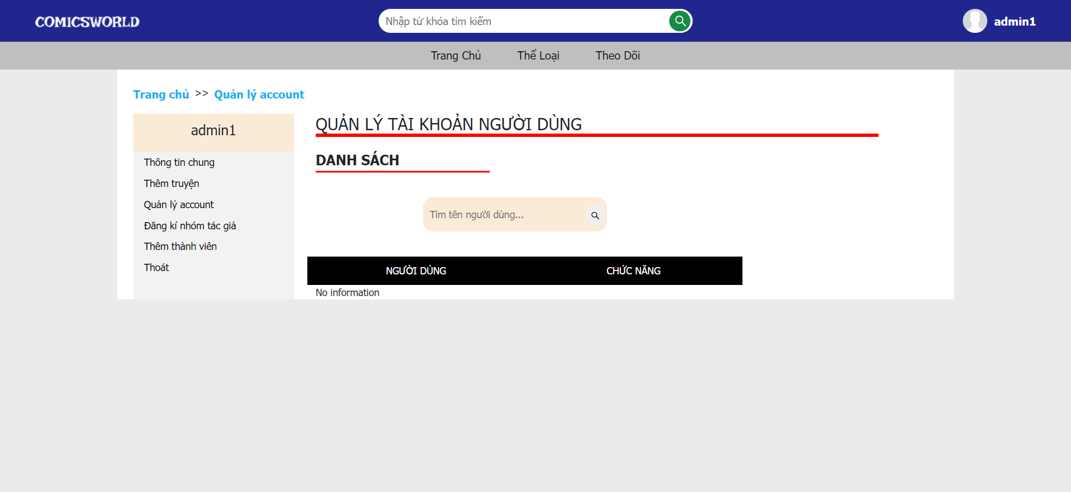
MANAGE ACCOUNTS

Slide 21
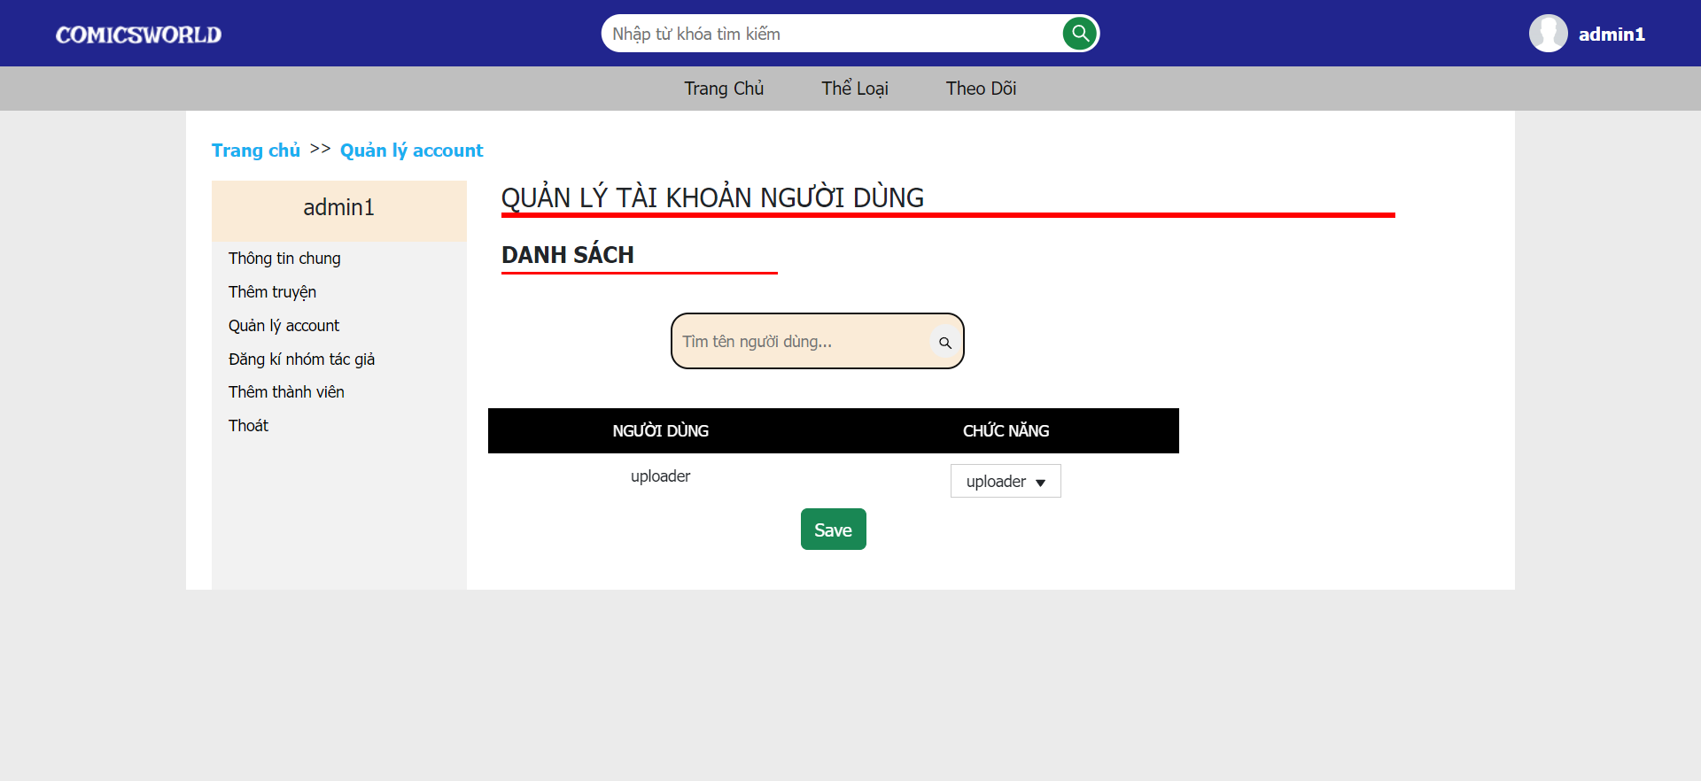
MANAGE ACCOUNTS
(SEARCH USER)

Slide 22
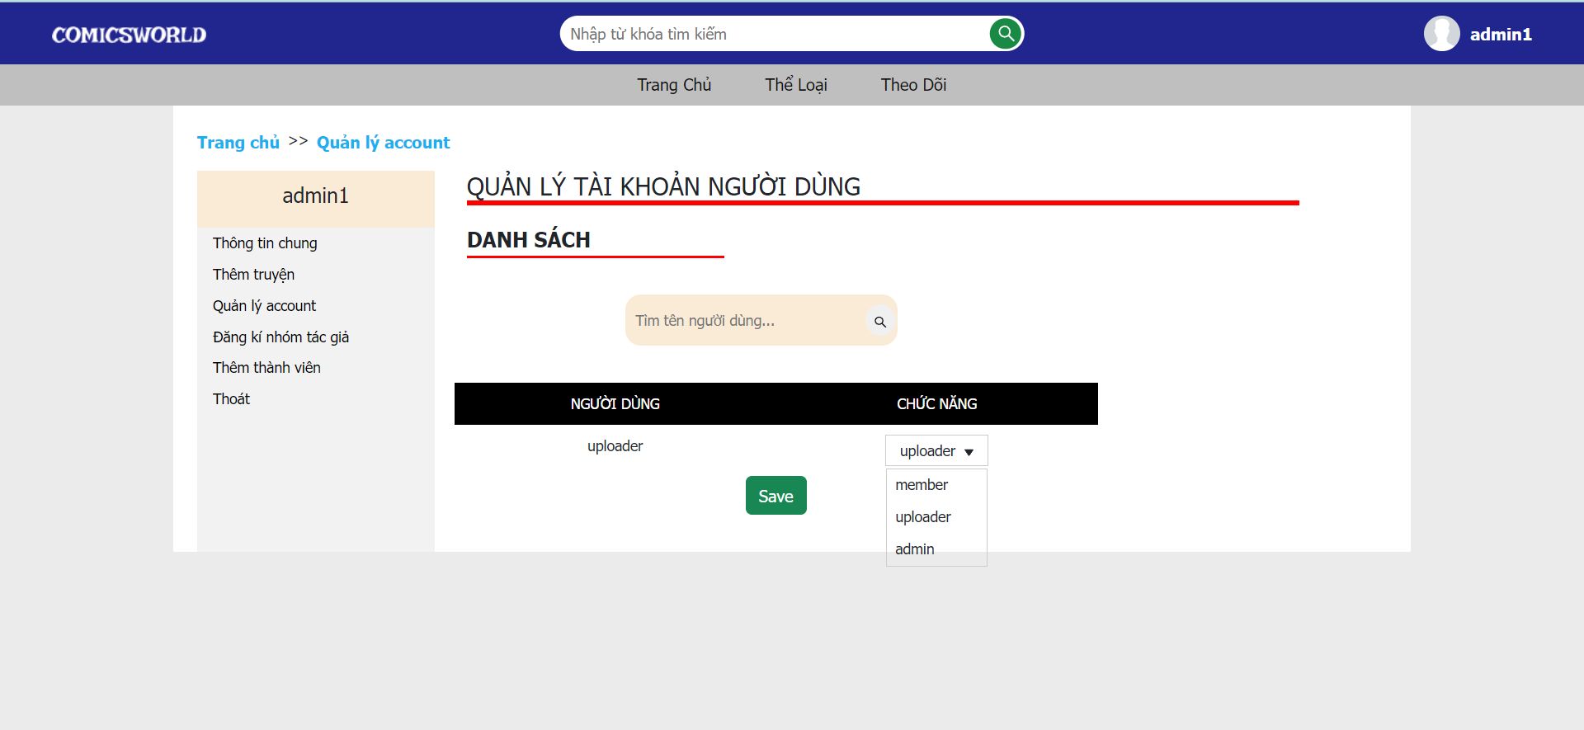
MANAGE ACCOUNTS
(CHANGE ROLE)

Slide 23
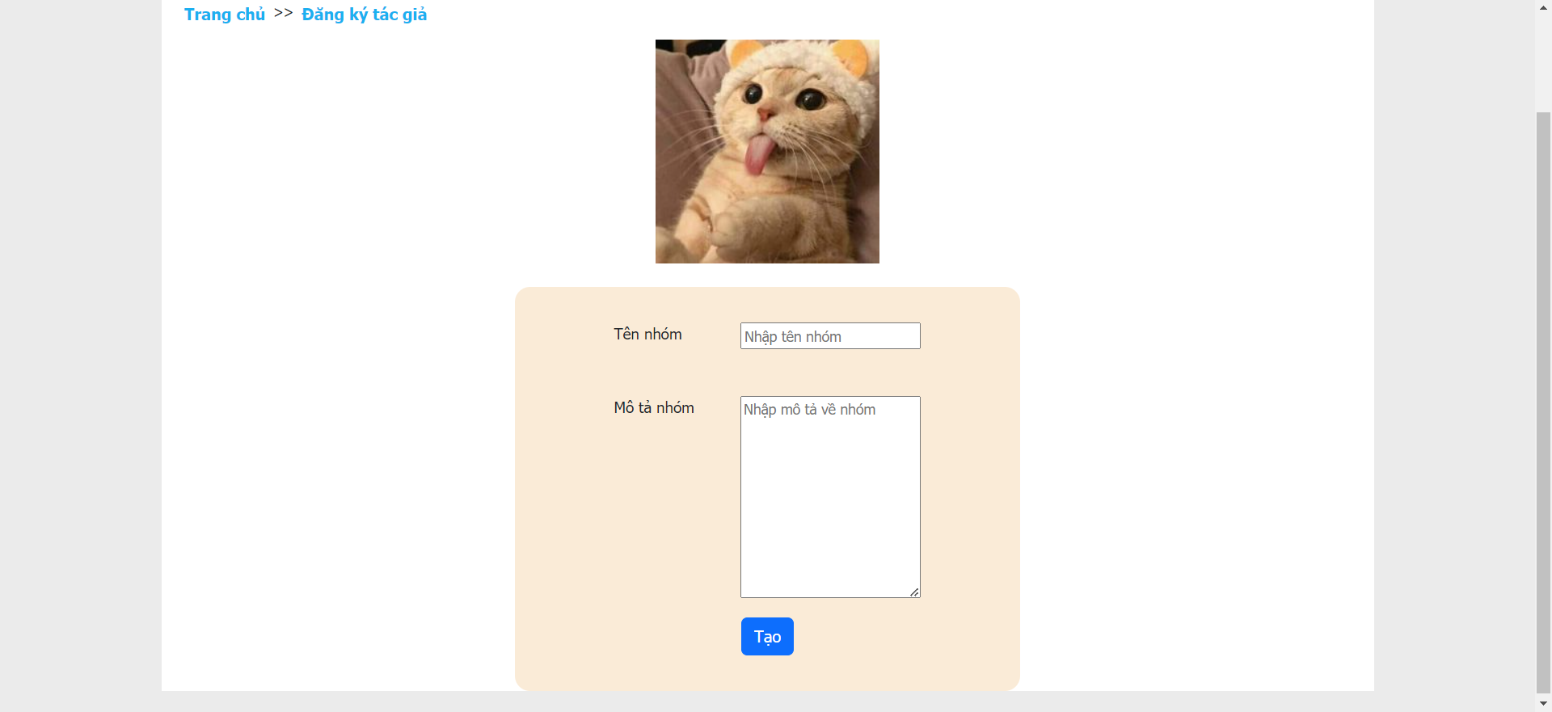
CREATE AUTHOR

Slide 24
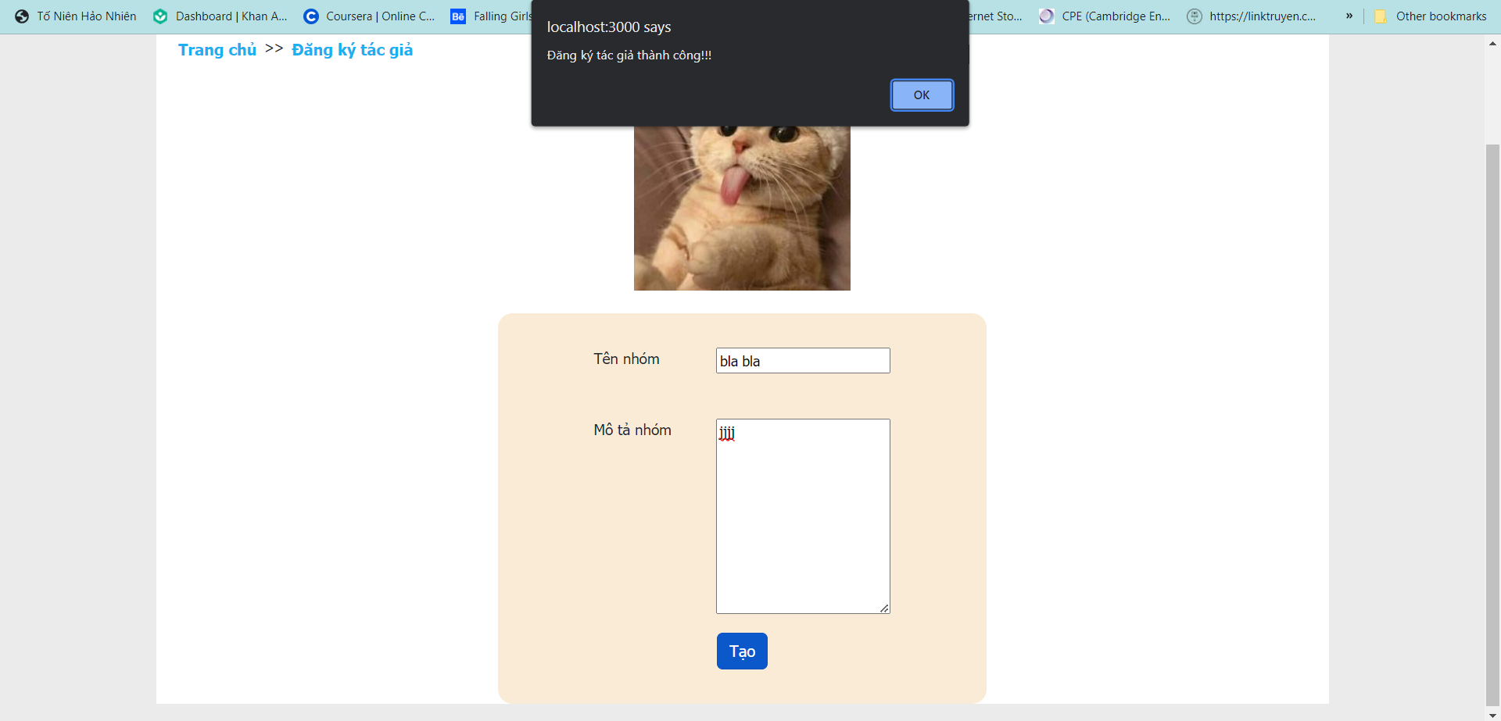
CREATE AUTHOR
(SUCCESSFULLY)

Slide 25
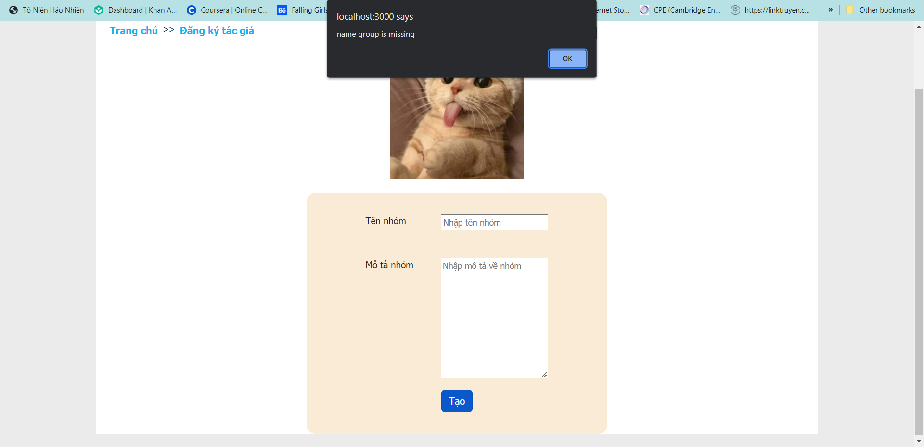
CREATE AUTHOR
(FAIL)

Slide 26
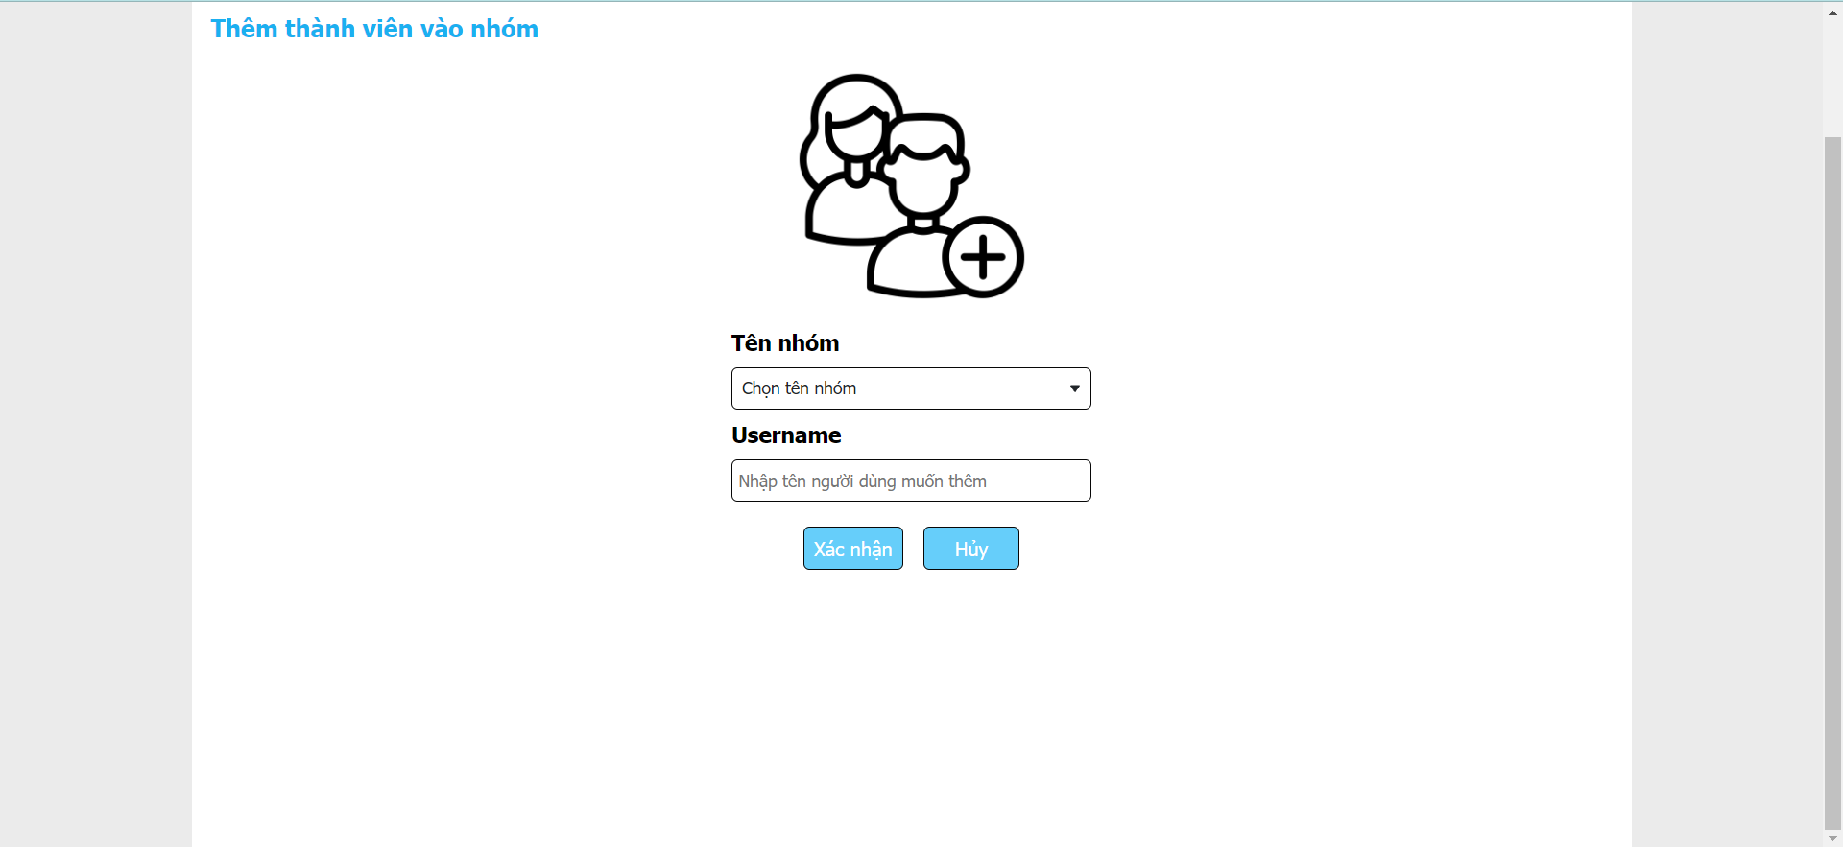
ADD MEMBER TO GROUP

Slide 27
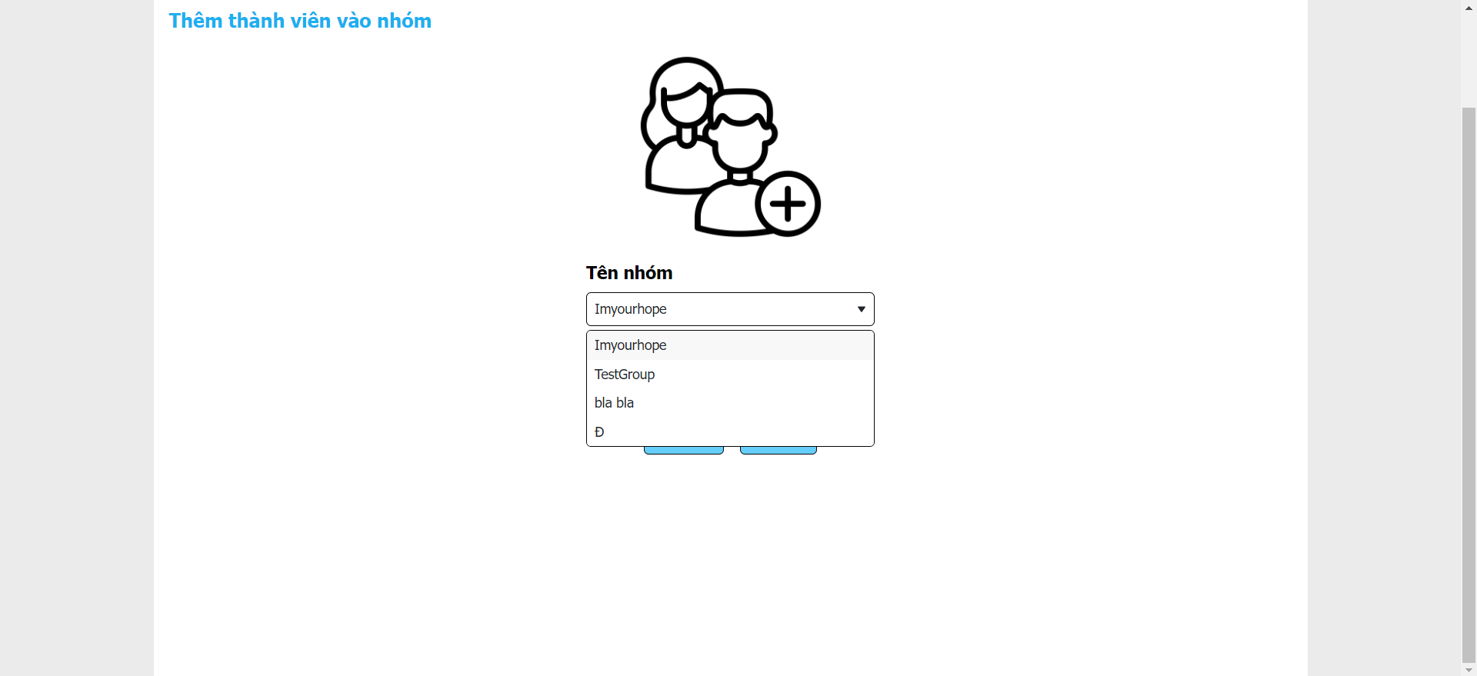
ADD MEMBER TO GROUP
(SELECT GROUP)

Slide 28
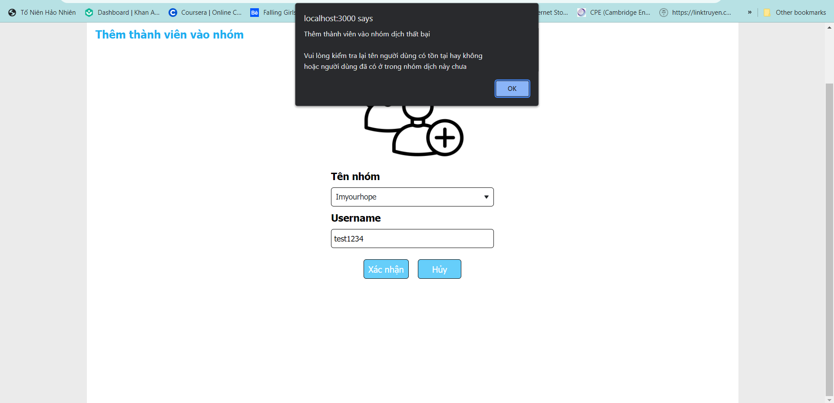
ADD MEMBER TO GROUP
(FAIL)

Slide 29
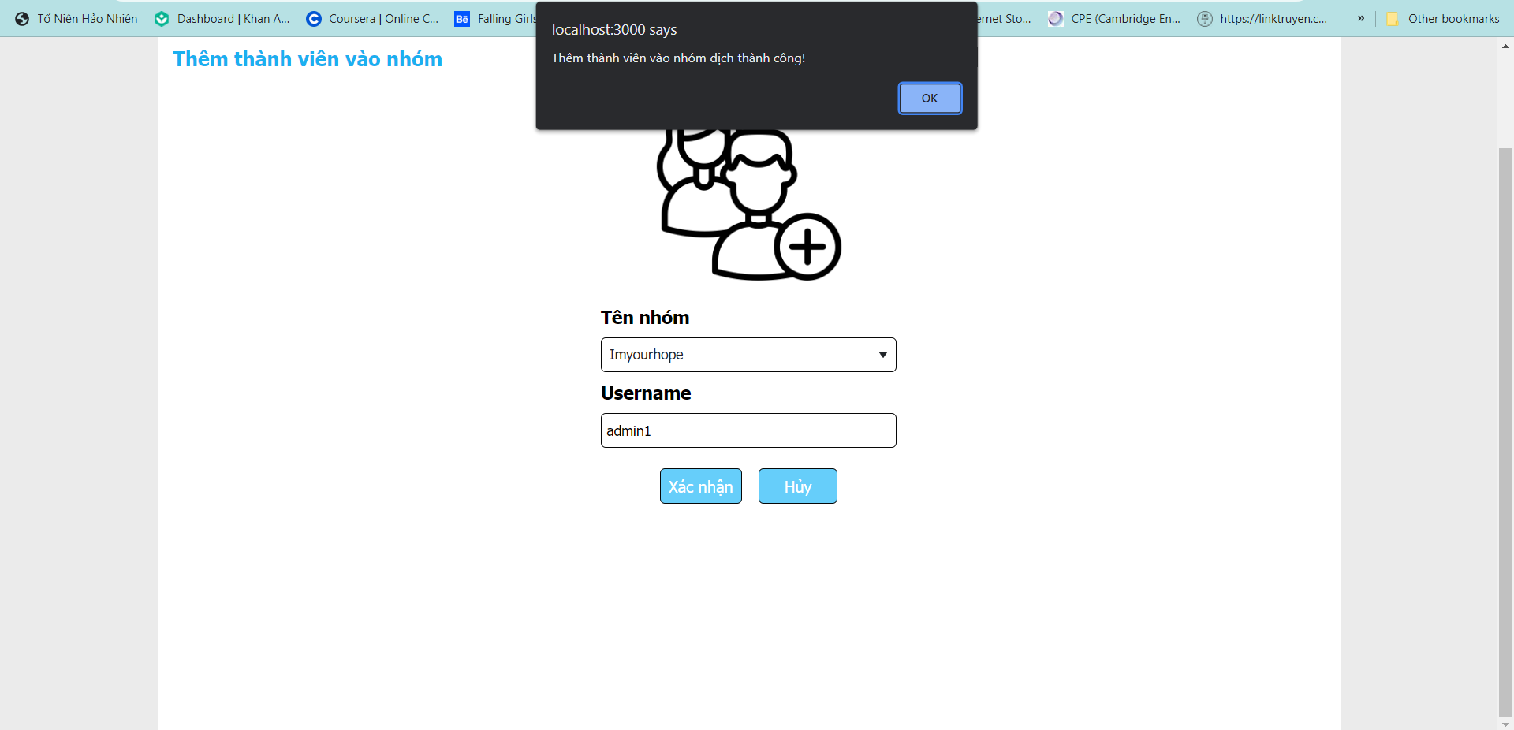
ADD MEMBER TO GROUP
(SUCCESSFULLY)

Slide 30
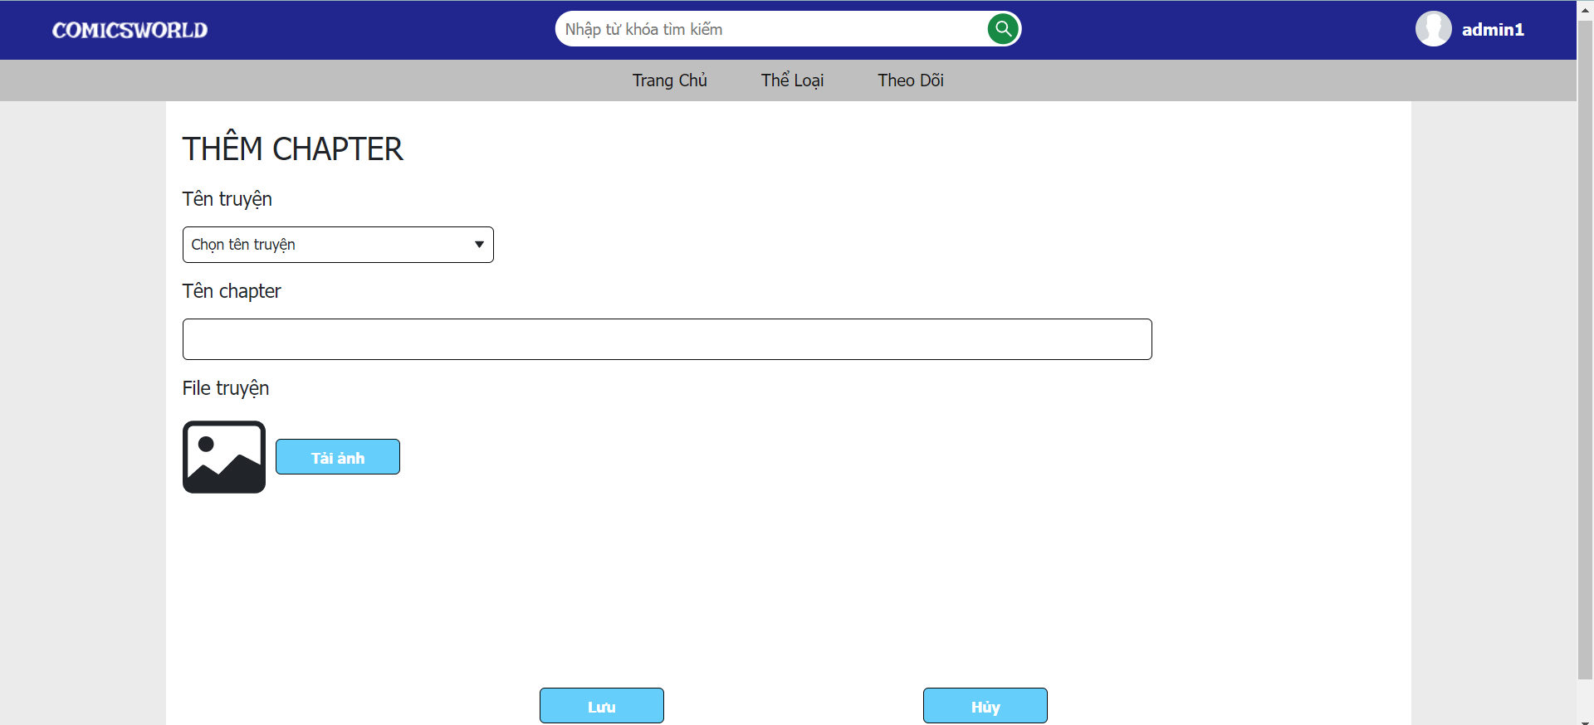
UPLOAD NEW CHAPTER

Slide 31
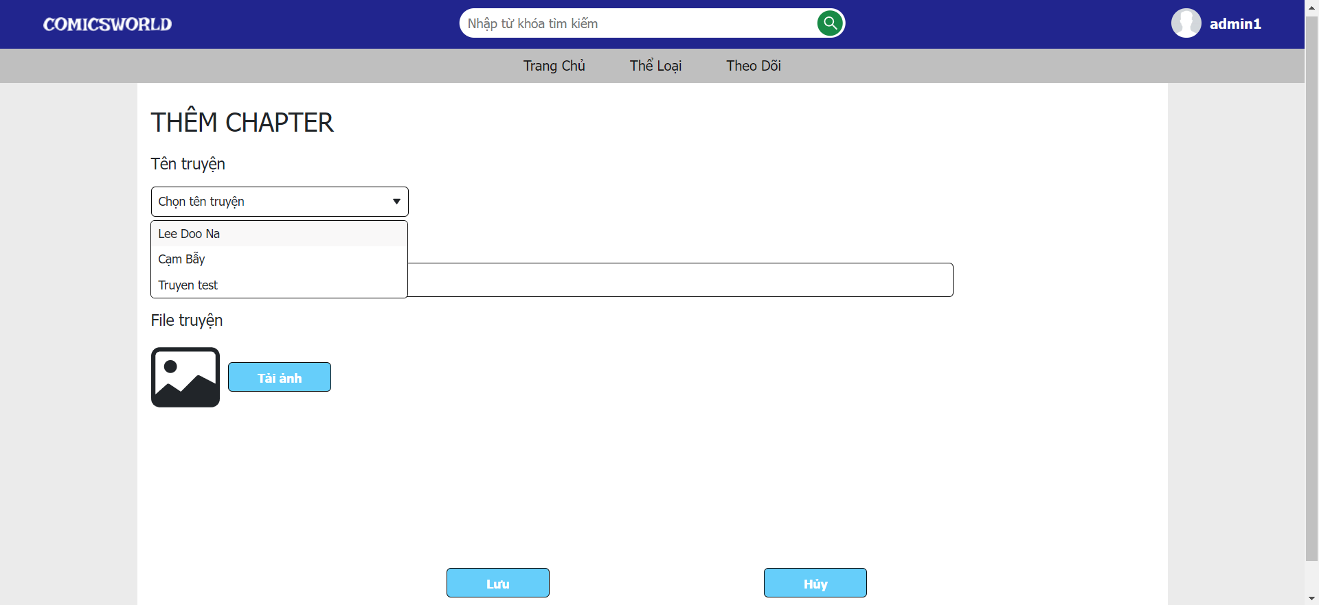
UPLOAD NEW CHAPTER
(SELECT COMICS)

Slide 32
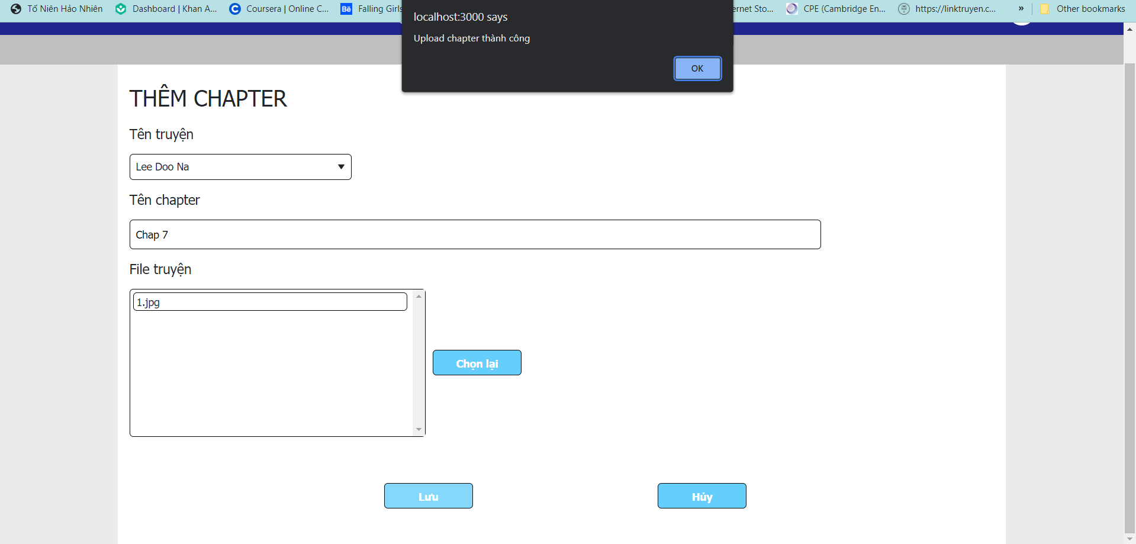
UPLOAD NEW CHAPTER
(SUCCESSFULLY)

Slide 33
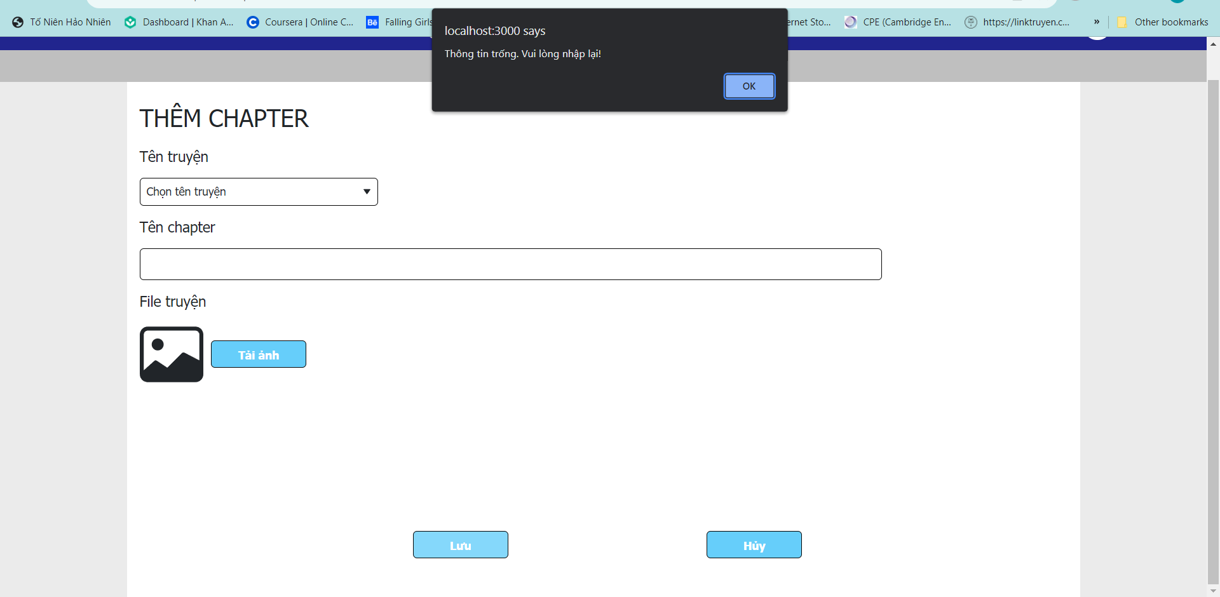
UPLOAD NEW CHAPTER
(FAIL)

Slide 34
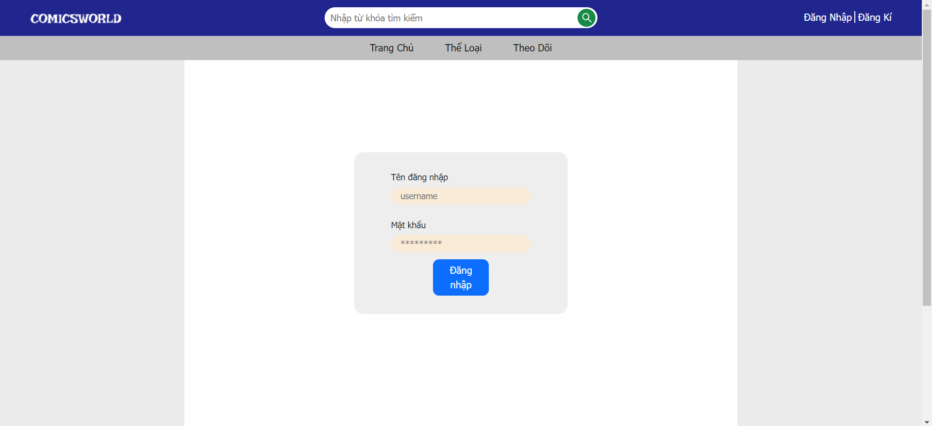
LOG IN

Slide 35
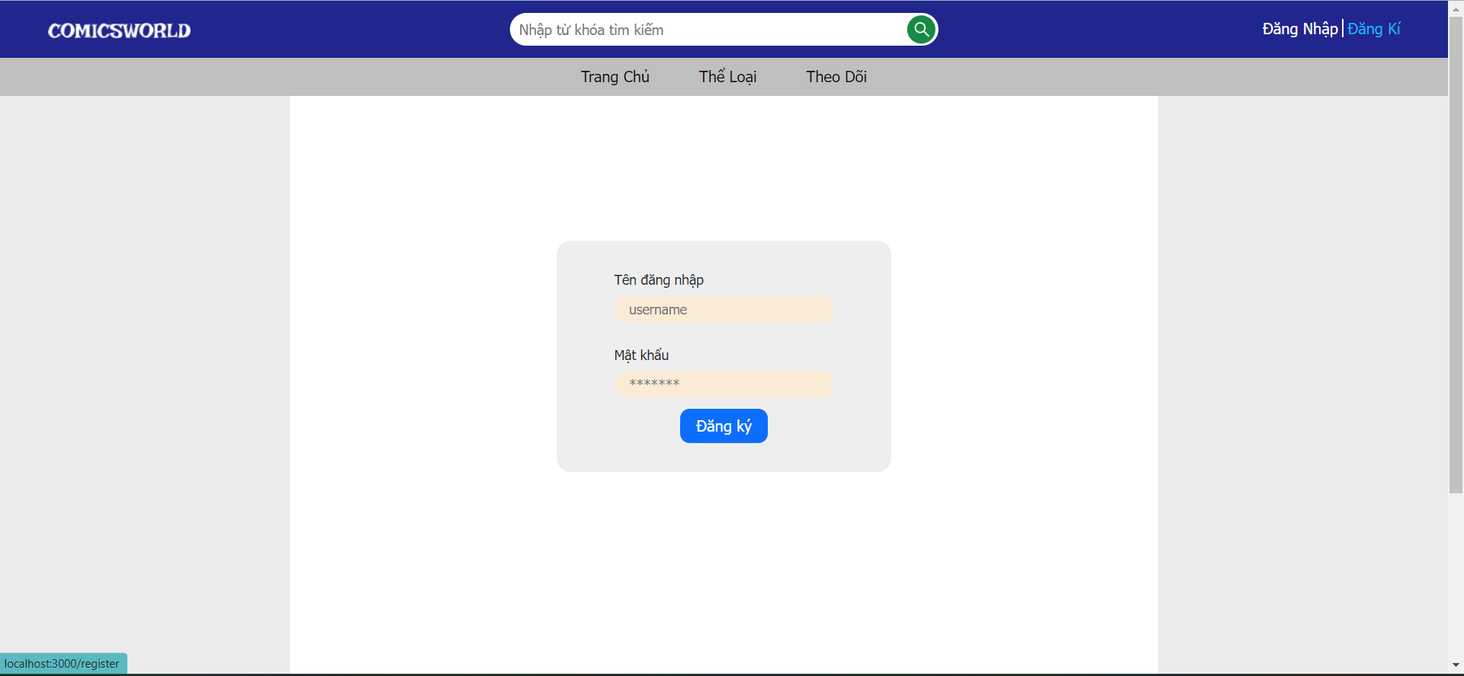
SIGN UP

Slide 36
“This is a quote, words full of wisdom that someone important said and can make the reader get inspired.”
GAORANGERS
Home
About us
Content
Reference

Slide 37
THANKS!
Do you have any questions?
gaorangers@legit.company.com
+34 654 321 432
comicsworld.com

